Slide 1

Predict Inflation using Interest rate
with VAR model Artur Bruev, Onur Berke Yesil, Othniel Jimmy Adu Mensah

Slide 2
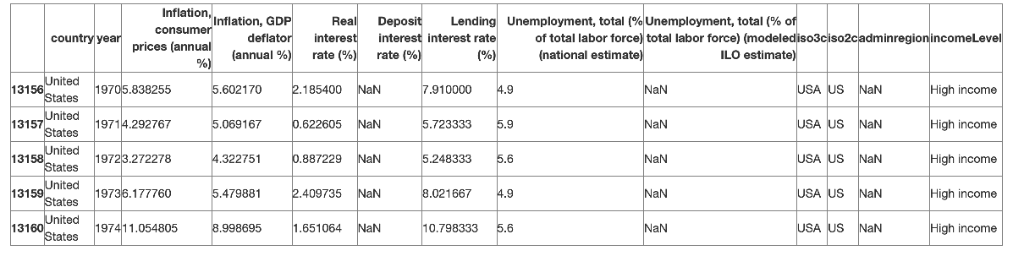
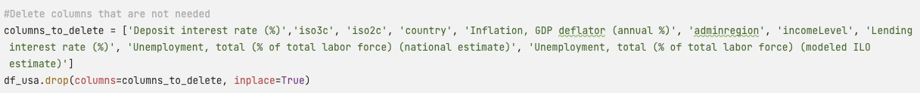
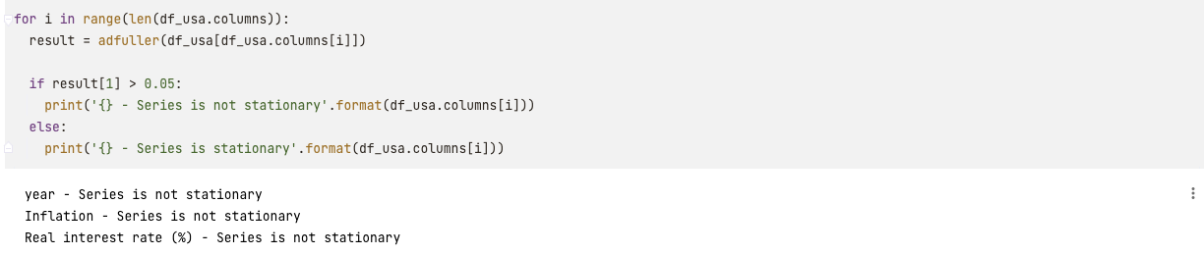
Preparation of data
We choose to use columns, which contains only United states values.
After deleting all nulls and columns which we don’t need for work, it was complete rename of category, such as Inflation.
Also, data was separate to ‘stationary’ and ‘not stationary’

Slide 3
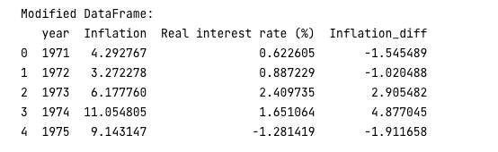
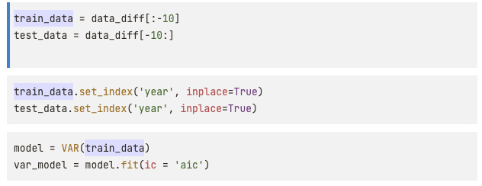
split of data and stationary
Data was again modified. Column “Inflation” become stationary. Missing values being dropped. Index to retain “year” as a column was reset.
And then it was splitted on
90% for training and 10% for testing

Slide 4
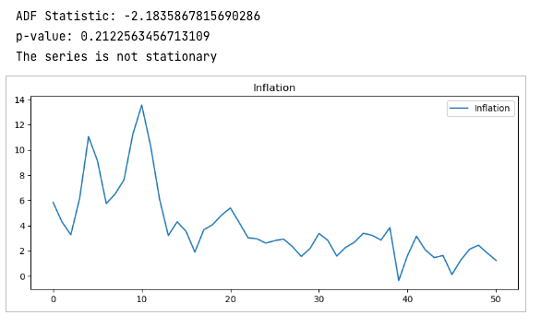
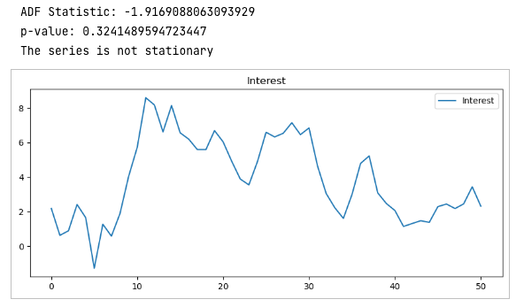
Check_Stationary
VAR model assumes that time series passed are stationary.
ADF test utilized from statsmodels library
Null-hypothesis of ADF test assumes timeseries has unit root which implies non stationary timeseries
P-value obtained from test shows whether the null hypothesis is rejected or not
If p-value < 0.05, there 95% probability that series not have unit root.

Slide 5
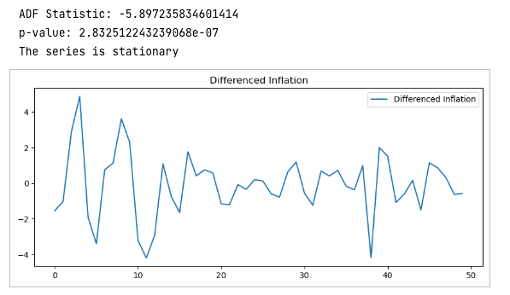
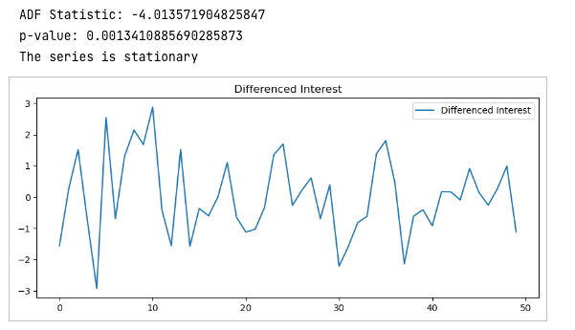
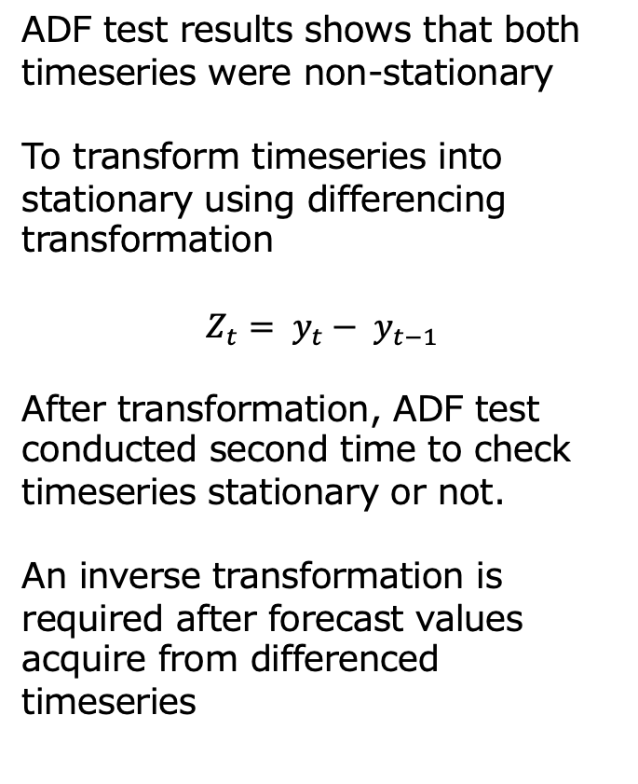
Difference Inflation and Interest
ADF test results shows that both timeseries were non-stationary
To transform timeseries into stationary using differencing transformation
$$Z_{t}= y_{t}− y_{t−1}$$
After transformation, ADF test conducted second time to check timeseries stationary or not.
An inverse transformation is required after forecast values acquire from differenced timeseries

Slide 6
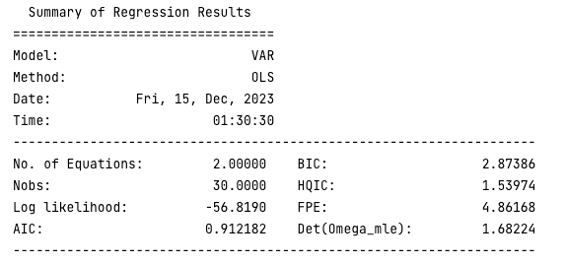
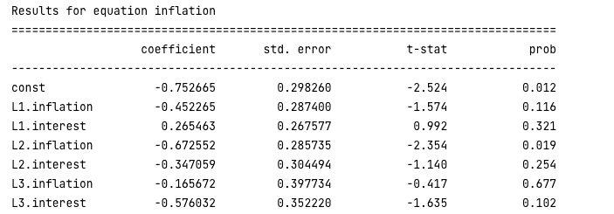
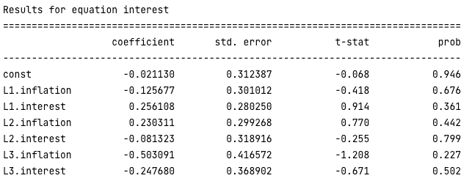
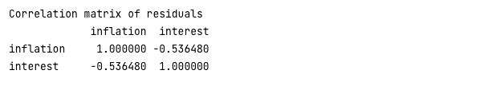
Summary of Different Results

Slide 7
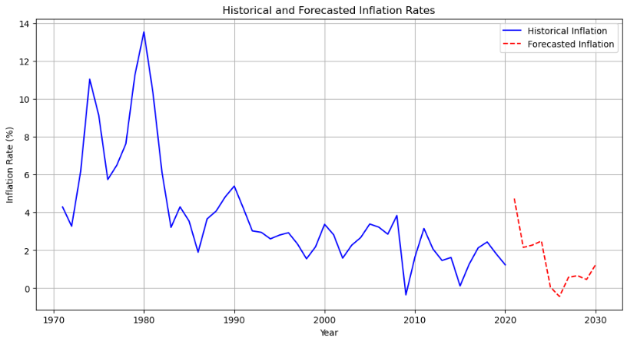
Historical and Forecasted Inflation Rates

Slide 8
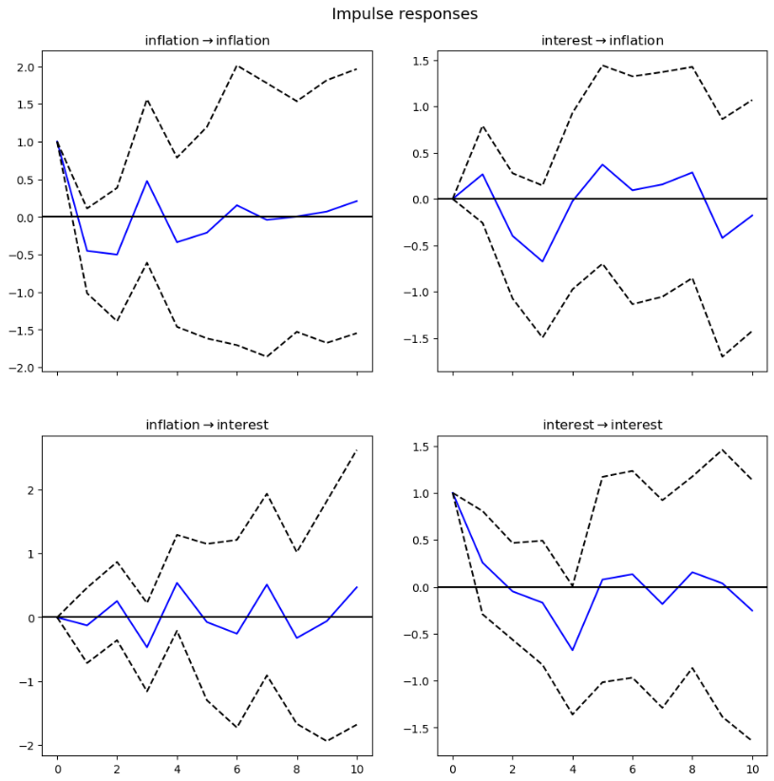
Impulse responses
To evaluate performance of forecast model IRF graphs plotted.
IRF graphs shows the reaction of inflation and interest rate to shocks in each other
Inf -> inf: There is a spike but diminishes fast, and graph oscilates around zero.
Int -> inf: After shock in int, there is response from that remains above 0 for long time.
Inf -> int: Dynamic responses goes above and below zero
Int -> int: Similar to inf->inf, after an initial reaction decreases continues oscillate around zero

Slide 9
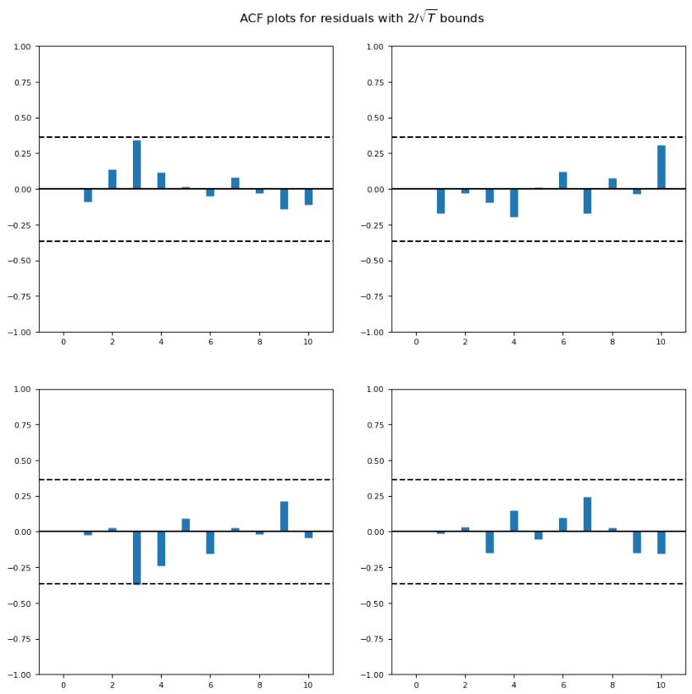
ACF plots
ACF plots used to provide information about autocorrelation of residuals for different lags.
If a bar exceed these threshold, it signifies correlations are statistically significant at corresponding lags.
Model capturing timeseries well with some room of improvement due the autocorrelation in certain lags.

Slide 10
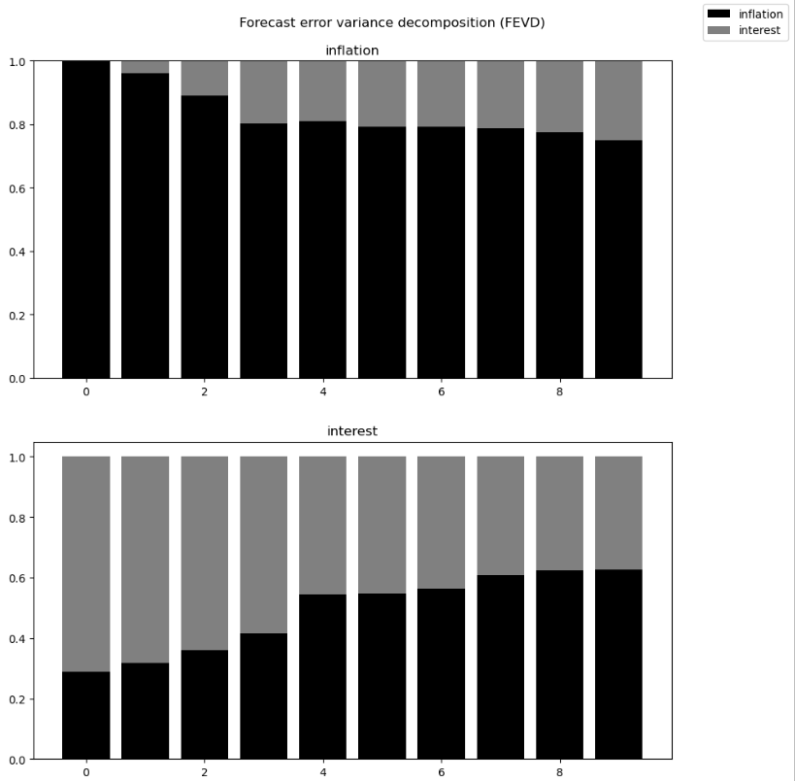
FEVD
Results indicated both series are influenced by its own shocks in short term, cross variable shocks shows importance over time.
The influence of inflation shocks on interest suggest inflation could be an important factor on interest rate forecast uncertainty.
Variability in inflation due interest shocks suggests interdependence between two.

Slide 11
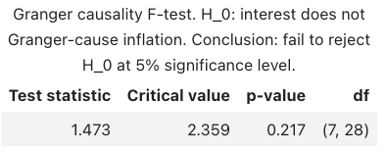
Granger causality test
Granger causality test is used to determine whether one time series can predict another.
Since test statistics is less than critical value, we don’t have enough evidence to reject null hypothesis
P-value if less than 0.05, this also indicates that we cannot reject null hypothesis
Its important to note that failing to reject null hypothesis is not prove it is true.

Slide 12
From Granger causality test, we can say that interest rates do not provide predictive power for inflation in context of data and time period.
Interest rates are still an important part of economical framework and influence inflation in various ways
Thanks for listening

